Slide 1
Advance AI
Course Instructor : Sangeeta Oswal

Slide 2
Section 01
Generative AI

Slide 3
AI is defined as “A system that shows behavior that could be interpreted as human intelligence.” - Doug Rose

Slide 4
Introduction to Generative AI
Generative AI refers to a type of artificial intelligence that has the ability to generate content that is, in many cases, indistinguishable from content created by humans. This AI can produce text, images, audio, or even video, often in response to a given input or prompt.
Generative AI is a branch of artificial intelligence that leverages neural networks to create original content by identifying patterns within existing data.

Slide 5
How Generative AI Works
It takes a prompt (which could be text, an image, a video, or any input the system can process) and generates new content in response.
This output could range from essays and solutions to problems to realistic fakes created from images or audio of a person.
Generative AI operates by learning patterns and structures from large datasets and then using that knowledge to produce new content that fits within those learned patterns.
It's a type of machine learning where the AI model learns to understand and mimic the characteristics of the data it has been trained on.

Slide 6
Examples
Text generation
This can be helpful for content creation, brainstorming, or even generating ideas for creative writing.
Image generation
This technology has been used to create realistic images of people, places, and objects that do not actually exist.
Video
deepfake videos or spreading misinformation has led to discussions around responsible use and regulation of generative AI technology.
Auditory
Music Generation
Voice generation
Language
Note Taking
Marketting
Code development

Slide 7
Types of Generative AI models
GAN+VAE+Transformer

Slide 8
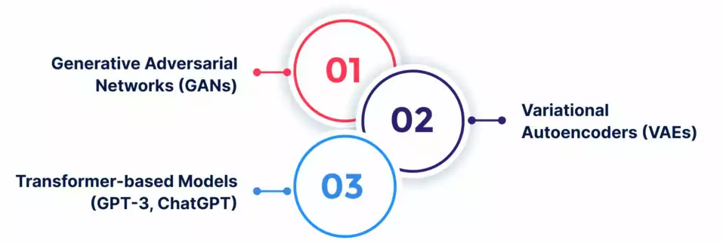
GAN Generative Adversarial Networks (GANs) were considered the most commonly used methodology before the recent success of diffusion models. GANs involve two neural networks working against each other: one network generates new examples, while the other learns to distinguish whether the content is real (from the domain) or fake (generated).
VAE : VAEs consist of two neural networks referred to as the encoder and decoder. Together, they work to learn an efficient and straightforward latent data representation, enabling easy sampling of new latent representations that can generate novel data. However, while VAEs can generate outputs faster, their images are not as detailed as those produced by diffusion models.
Transformer: Transformer-based models such as OpenAI’s GPT-3 and ChatGPT use a specific type of architecture called transformers to understand and generate human-like text. These models have taken the generative AI landscape by storm, with applications ranging from writing essays to conducting interactive conversations with users.

Slide 9
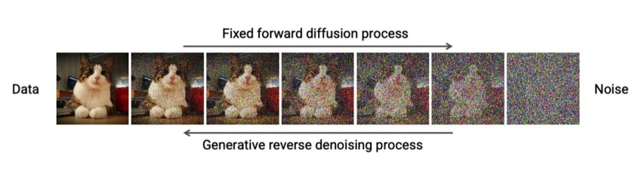
What are Diffusion Model
Diffusion models are generative models that determine vectors in latent space through a two-step process during training.
The two steps are forward diffusion and reverse diffusion.
The forward diffusion process slowly adds random noise to training data, while the reverse process reverses the noise to reconstruct the data samples.
Novel data can be generated by running the reverse denoising process starting from entirely random noise.
Learn More

Slide 10
Challenges in Generative AI
Scale of compute infrastructure
Lack of high-quality data
Sampling speed
Safety and Privacy
Prompt Sensitivity

Slide 11
Reflection
Elite University, a renowned higher education institution, has a highly competitive college admissions department that receives thousands of applications each year. To improve their efficiency and provide a better experience for applicants, Elite University decided to implement generative AI solutions. This case study details how the college admissions department leveraged generative AI to enhance their performance.
We are going to test chatGPT’s effectiveness on some real-world scenarios.
Warm up: Consider what aspects of your work could be enhanced or made easier by using Generative AI.
Questions to ask yourself:
what tasks are repetitive in my job?
what kind of writing do you do that could be done by AI?
what projects could you use help organizing or starting?

Slide 12
What is Prompt Engineering?
Prompt engineering is the process of designing and crafting input prompts or queries to generative AI models to elicit desired outputs or responses. The choice of words, format, and context in the prompt can significantly influence the generated content.
How to structure prompts for desired outputs:
Be Clear and Specific
Specify the Format
Add Context
Use Examples
Control the Tone

Slide 13
Examples
Task: Summarize a Report
Ineffective Prompt: "Summarize this report."
Effective Prompt: "Provide a concise summary of the key findings and overarching messages of the GLBA Audit Findings: [paste report here]. "
Task: Creative Writing
Ineffective Prompt: "Write a story."
Effective Prompt: "Create an engaging short story about a time traveler who finds themselves in a parallel universe where gravity behaves differently."
Task: Language Translation
Ineffective Prompt: "Translate this sentence."
Effective Prompt: "Translate the following English sentence into French: 'The quick brown fox jumps over the lazy dog.'"

Slide 14
Ethical Concerns

Slide 15
Bias and Fairness: AI systems can inherit biases from the data they are trained on, potentially leading to discrimination in areas like admissions, hiring, or grading.
Privacy: AI may process and store sensitive student or faculty data, raising concerns about data security and privacy violations.
Transparency: The opacity of some AI algorithms makes it difficult to understand how decisions are reached. This lack of transparency can raise ethical questions about accountability and trust.

Slide 16
Accountability: It can be challenging to assign responsibility when AI is used in decision-making processes. Determining who is accountable for AI-related outcomes or errors is an important ethical consideration.
Data Quality: Garbage in, garbage out: If AI systems are fed with poor-quality or biased data, the ethical integrity of the resulting decisions is compromised.
Consent: Collecting and using personal data for AI applications should involve informed consent. Universities must be transparent about data usage and give individuals the option to opt in or out.

Slide 17
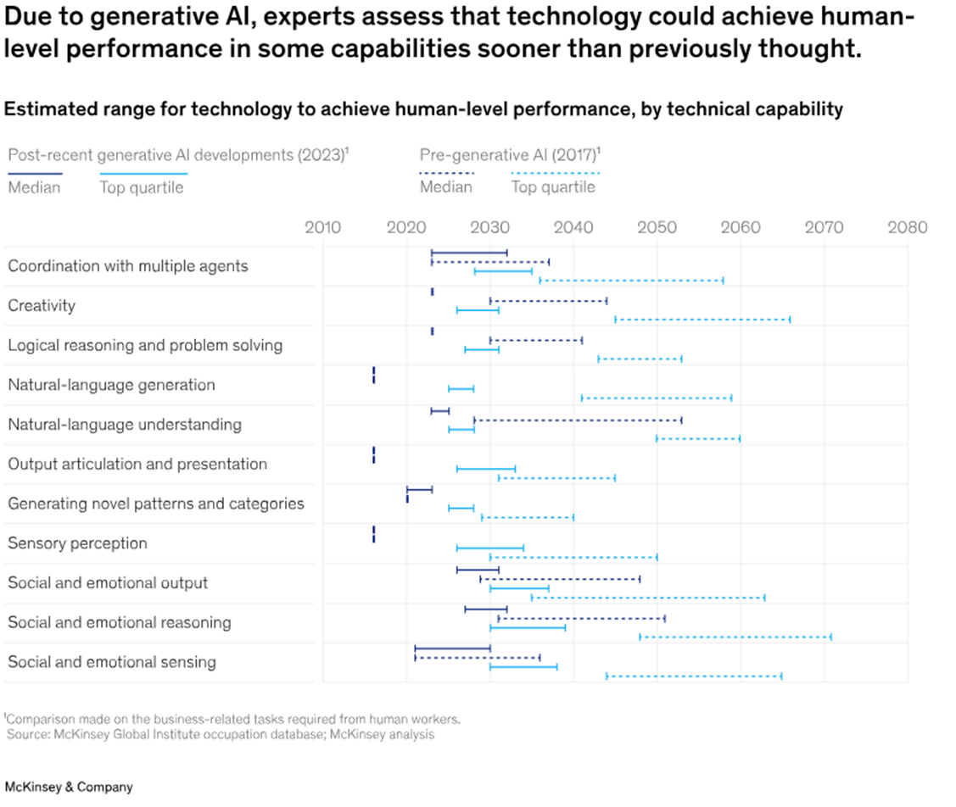
Future Trends
For most of the technical capabilities shown in this chart, gen AI will perform at a median level of human performance by the end of this decade. And its performance will compete with the top 25 percent of people completing any and all of these tasks before 2040. In some cases, that’s 40 years faster than experts previously thought.

Slide 18
Conclusion
AI is not going away, and learning how to use it appropriately is important. It is not coming for your job, but can make you much more productive.
Being mindful of how we use this new technology, and how we can shape our jobs with it will determine the future of its efficacy.
Through intentional exploration we can innovate in ways we have not dreamed of.
Common sense will prevail in most situations.

Slide 19
Tools, Platforms, and Software
ChatGPT – chatbot, text generator
Midjourney/Dall-E2 –text to art
Wisdolia – plugin, generate flash cards for any website, video, or PDF you are on.
RunwayML – Extreme video/picture editing.
Microsoft 365 copilot – brings AI across the entire Microsoft office suite
Eleven Labs – voice recognition. You speak to it, then you can feed it scripts and it will read them in your voice and cadence.
Synthesia – create a realistic avatar that can speak any script it is given.
Mixo/Sitekick – type a product idea and it creates a full website.
Tome – makes presentations from simple prompts.
Tableau’s Ask Data – ask questions, receive data visualizations as responses

Slide 20
Generative Modelling Framework

Slide 21
Generative Modelling Framework
We have a dataset of observation X
We assume that the observations have been generated according to some unknown distribution , Pdata.
We want to build a generative model Pmodel that mimics Pdata.
If we achieve this goal, we can sample from Pmodel to generate observation that appear to have been drawn from Pdata
Therefore the desirable properties of pmodel are:
Accuracy
Generation
Representation

Slide 22
Core Probability Theory

Slide 24
Sample Space : complete set of all values an observation X can take
PDF:p(x) maps x in sample space to a number between 0 and 1
Parametric modelling: find suitable pmodel(x).Its a family of density functions.
Likelihood

Slide 26
Representation Learning
Rather than modelling high dimension sample space directly , a low dimension latent space is used to describe an observation
Learns a mapping function
i.e each point in latent space is a represtation of some high dimensional observation
Encoders and Decoders

